Slide 1
SURGE 2020 Narrative presentation
Montgomery 1960

Slide 2
Narrative team problem
The Destiny and I were/are charged with finding ways to make the story more engaging while at the time maximizing empathy building within the story. We do this by looking over the Gems identified by the history team. After identifying the gems, we think of ways we can write the gem into the game in a way that makes it as engaging as possible.
For the empathy part, I will be turning in many of the gems to the empathy team and we will work out ways together to word the gems in the game to maximize empathy while also being compatible with the engagement of the game
Solving this problem is important because a big problem many people have with learning about Civil Rights is that they feel very disconnected from these problems, especially if they are from non-marginalized groups. Most information about the civil rights are also very big text walls and not very engaging, so making the story as engaging and empathetic as possible will help greatly in solving these problems

Slide 3
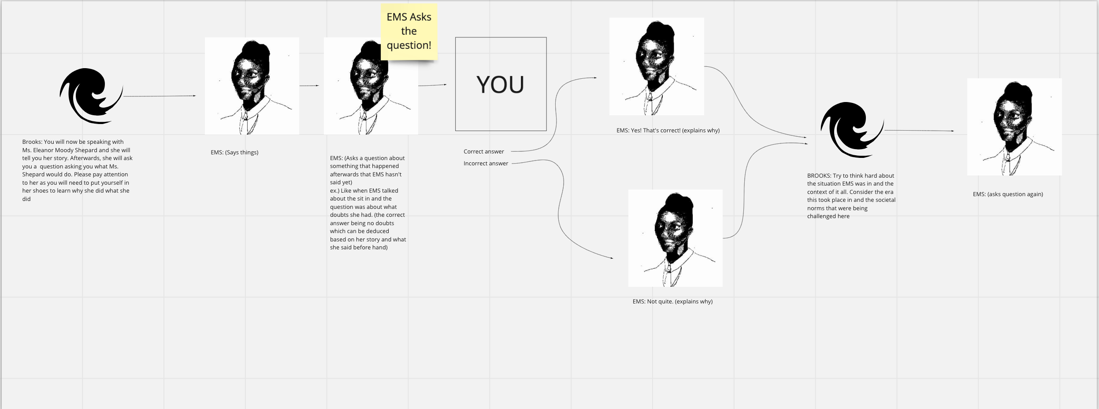
Contributions
Some things I contributed to the game were ways we could re-work the brooks into the game to better serve the player and the game as a whole. For me, that involved trying to design the brooks in a way that made the story more empathetic by letting the activist play a bigger role in question inquiry and response.

Slide 4
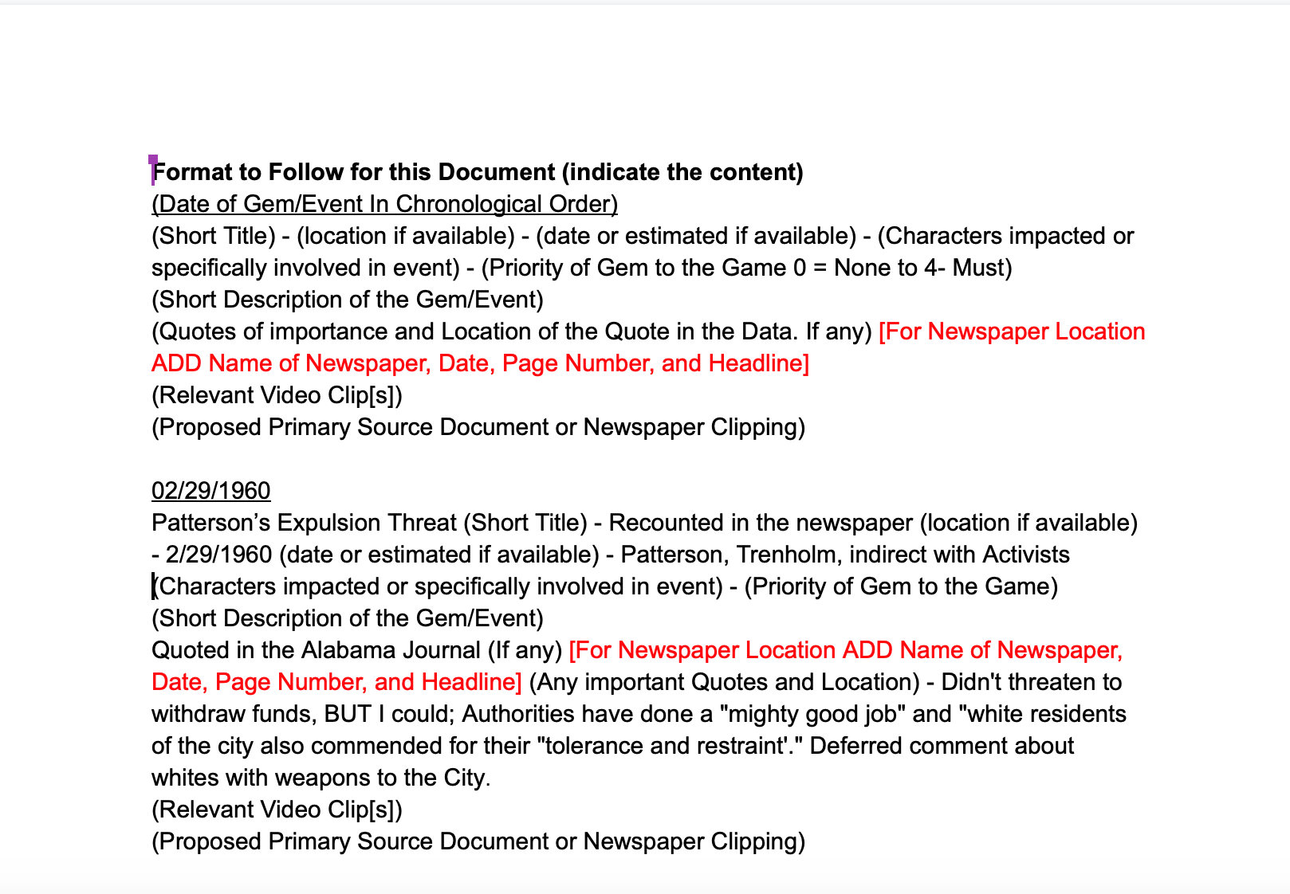
Contributions
I also was charged with compiling all the gems into chronological order and with priority ranking. This will help greatly for future projects and work as it will let anyone look through the gems in an easy and accessible location, which is a great improvement from the already great wireframe sheet

Slide 5
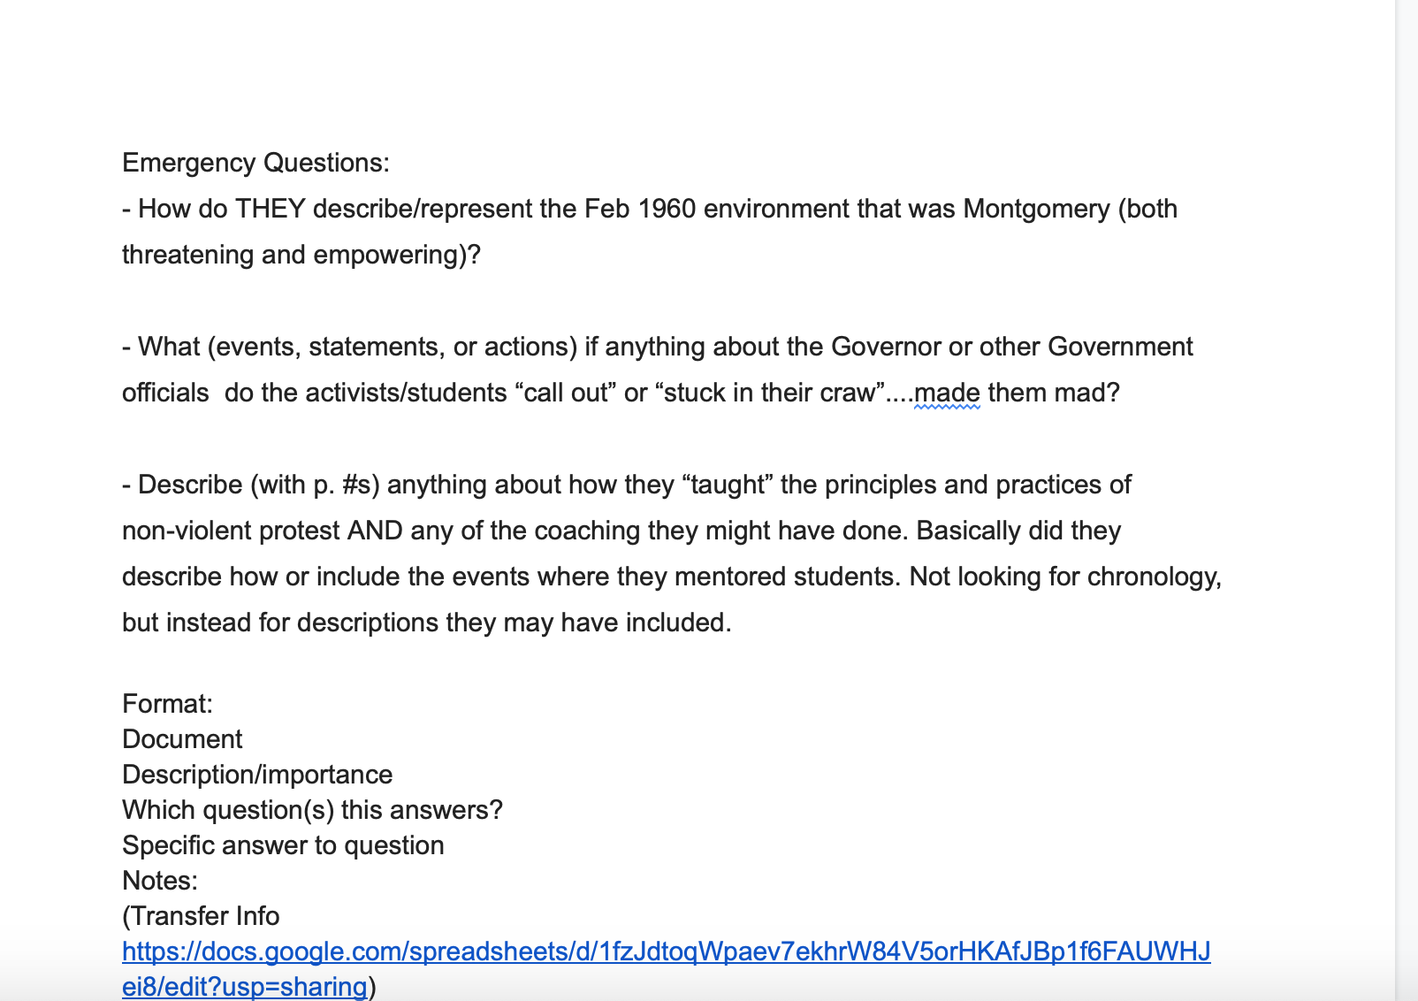
Contributions
Lastly, I have also been working on the emergency questions and helping to figure those out by looking through different documents

